Slide 1


Automated Water Resources Analysis Using USGS Data in Chesapeake Bay Watershed
5 August, 2020 Group 2
Ruoyu Zhang, Yibo Wang, Hyunglok Kim, Keyu Chen & Yusheng Jiang

Slide 2
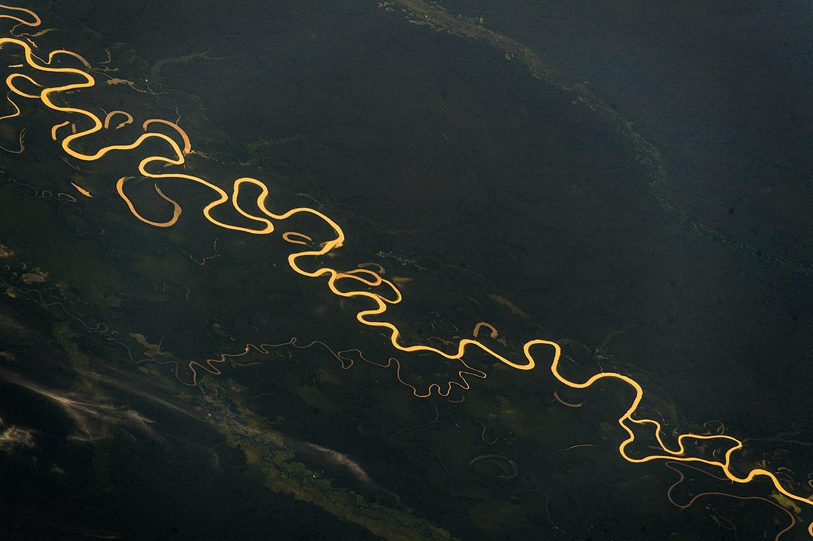
Introduction: Why Water?
Stream water is the major freshwater sources for human activities
Due to climate change:
The spatial distribution of stream water may change
We will be likely to experience more hydrologic hazards (i.e., flood and drought)
Before we predict the future, we need to understand how water behaved in the past
Notes:
Water is so important that no one can survive without it
Current distribution of water resources will be altered by the precipitation

Slide 3
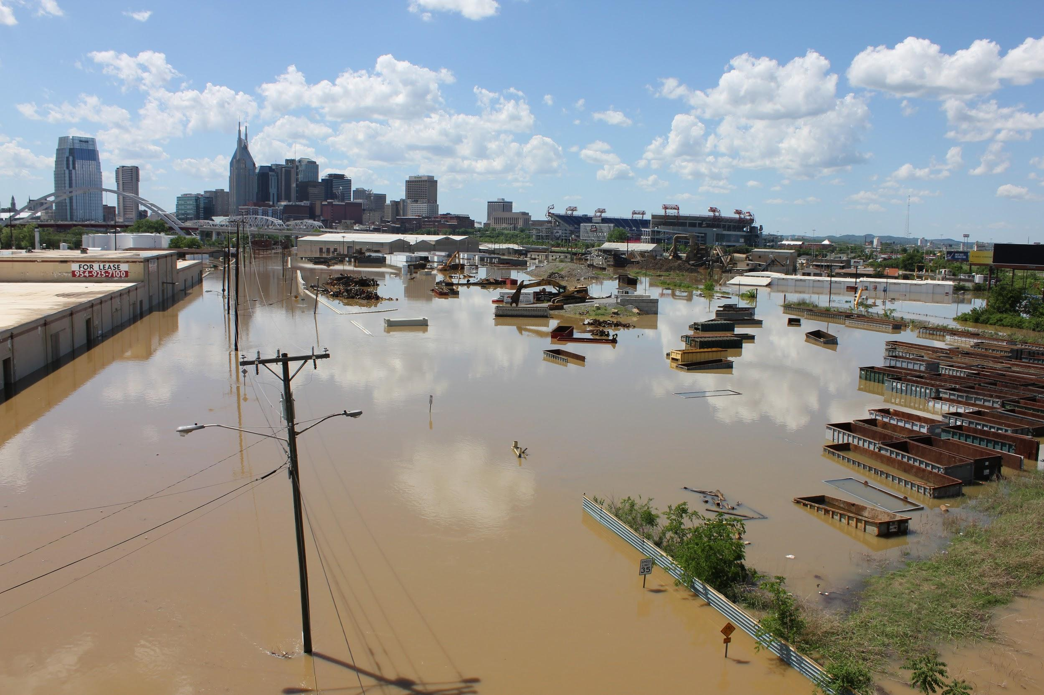
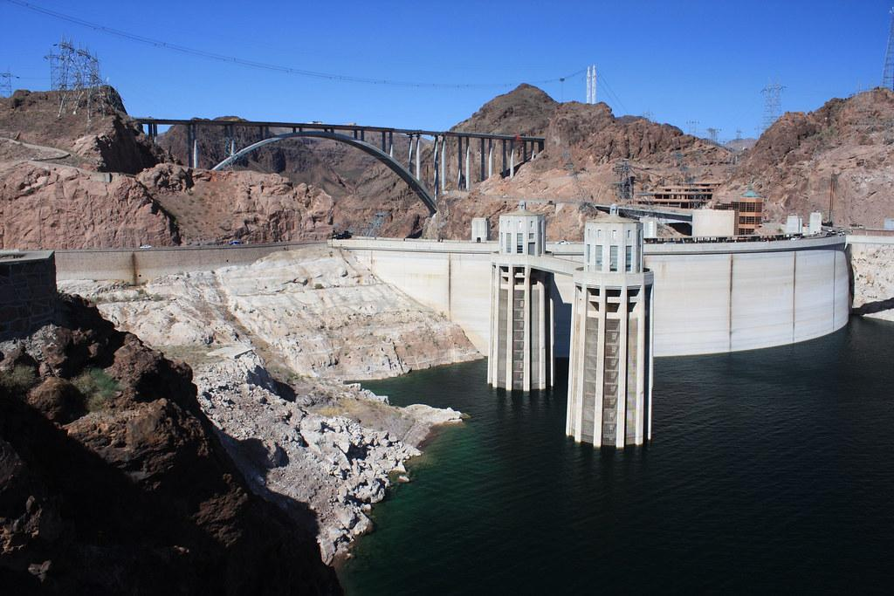
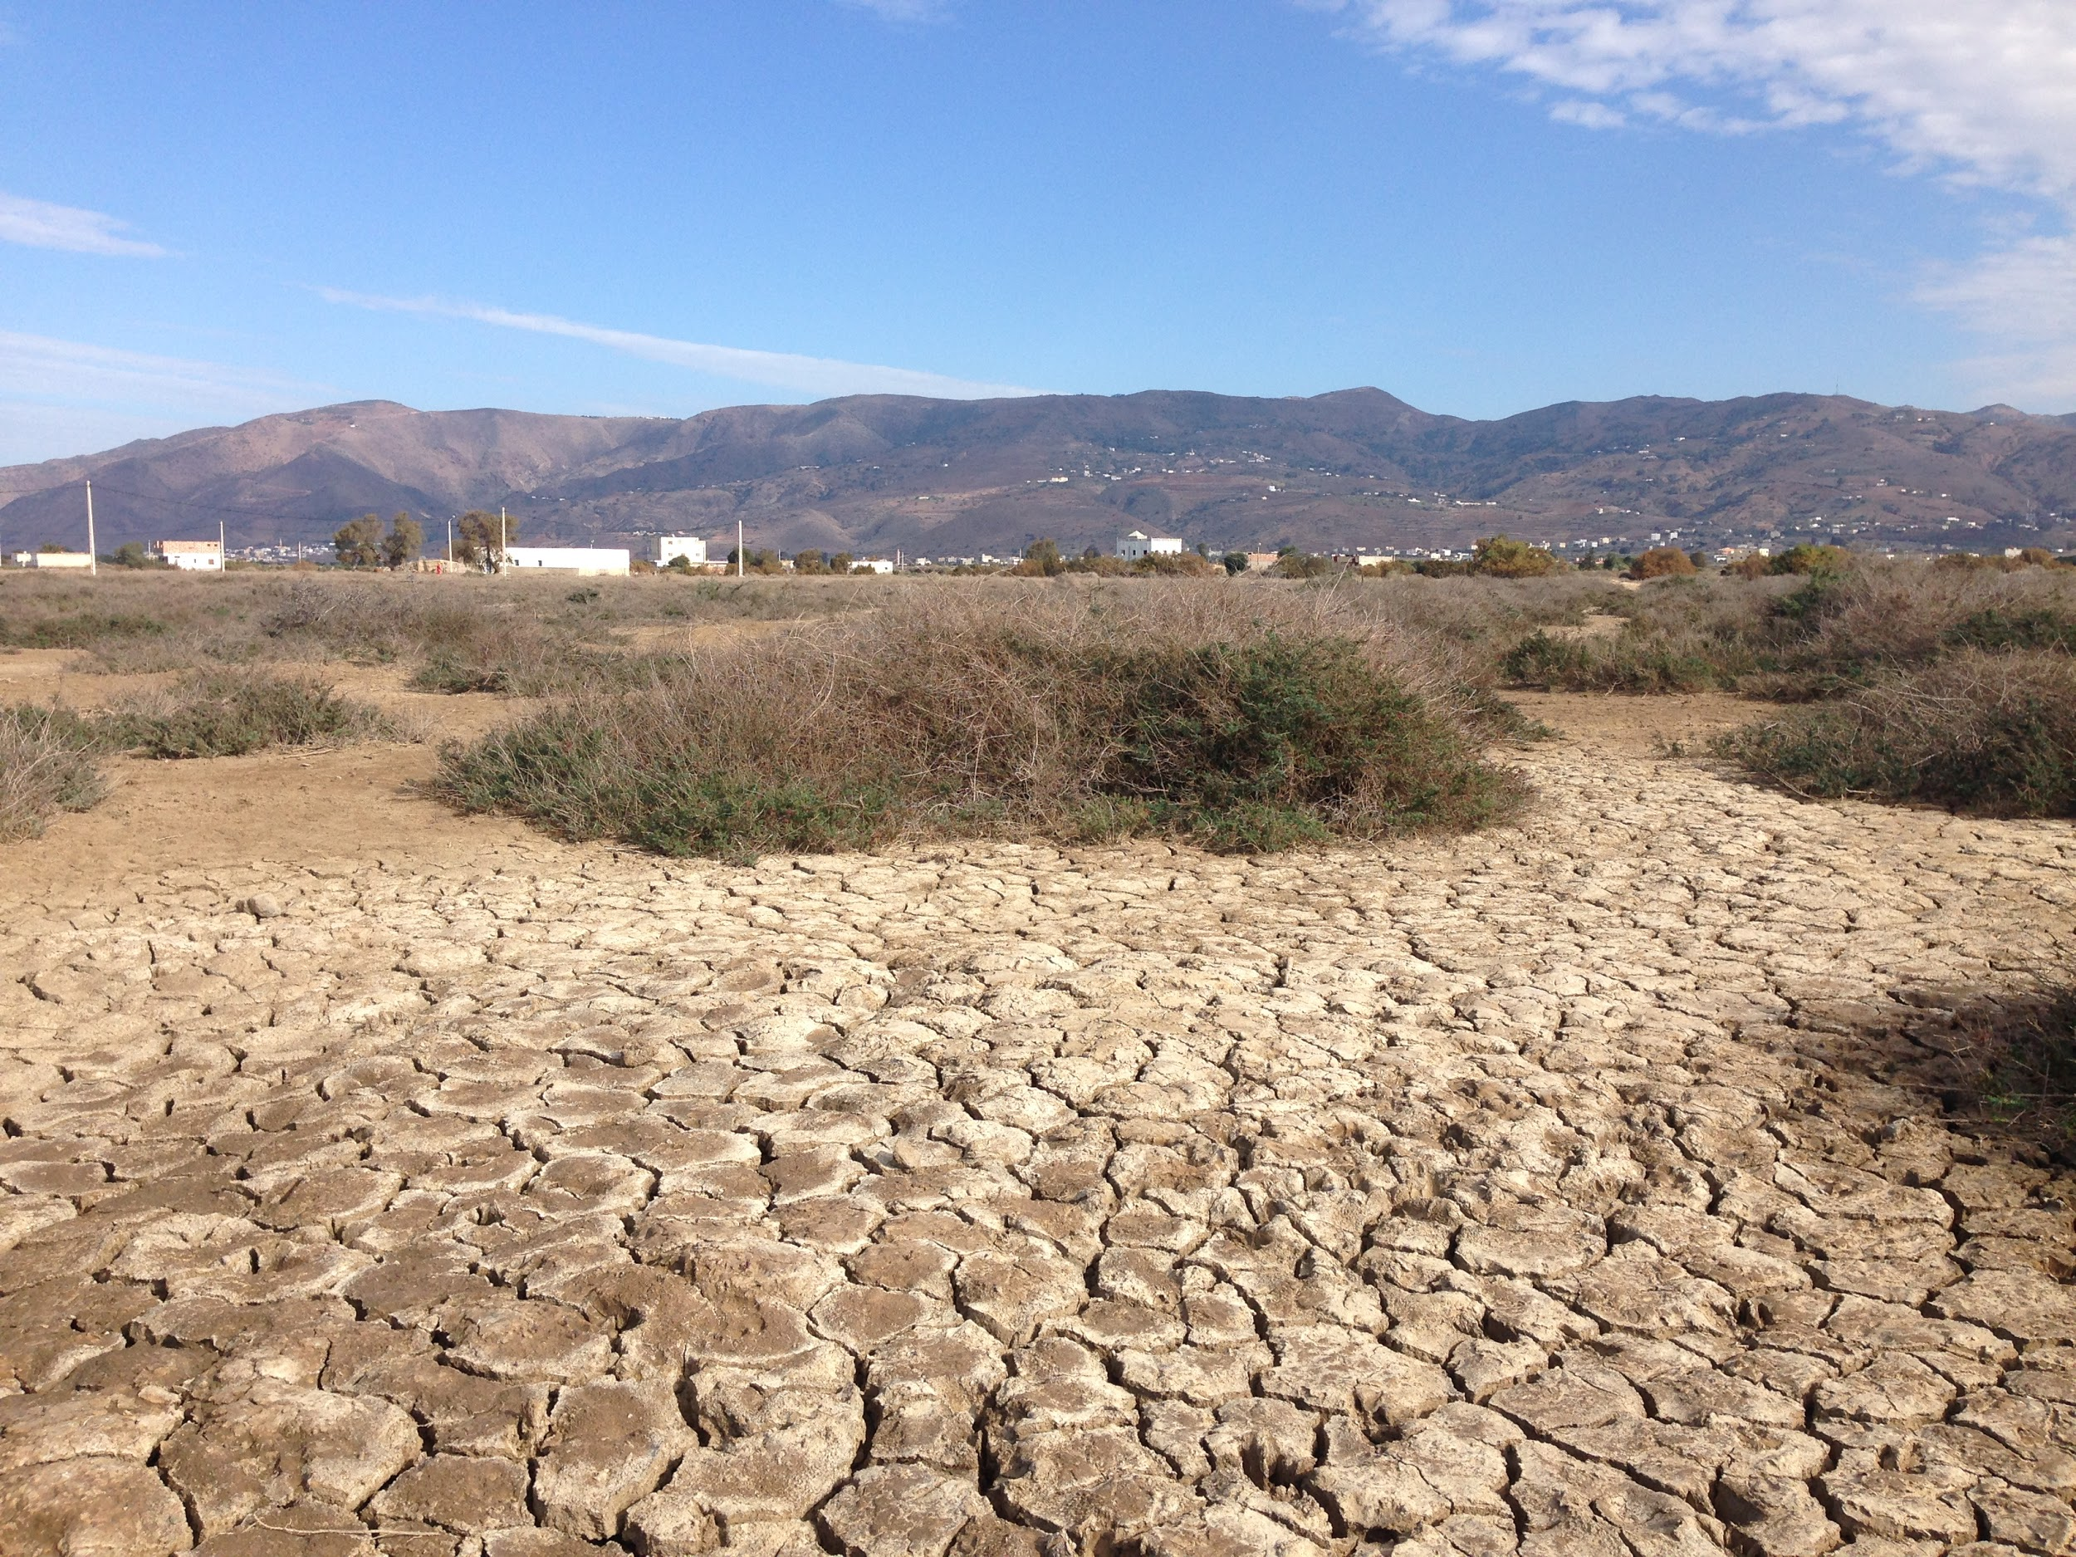
Goals
Develop a program to automate water data downloading from USGS
Analyze streamflow changes over time in the Chesapeake Bay
Detect spatial patterns of long-term water resources change

Slide 4
Python Package Development
We developed a Python program that can:
The United States Geological Survey (USGS) monitors streamflow at gages cross United States
BUT, downloading streamflow data is not user-friendly from USGS website
Download daily discharge data for a gage with only one input, the gage ID
Get the metadata of the gage using web-scrape
Calculate statistics of the daily discharge data
Plot the time-series
Test the trend of streamflow at monthly or yearly interval
Live Demo: https://waterdata.usgs.gov/va/nwis/uv?site_no=02032515

Slide 5
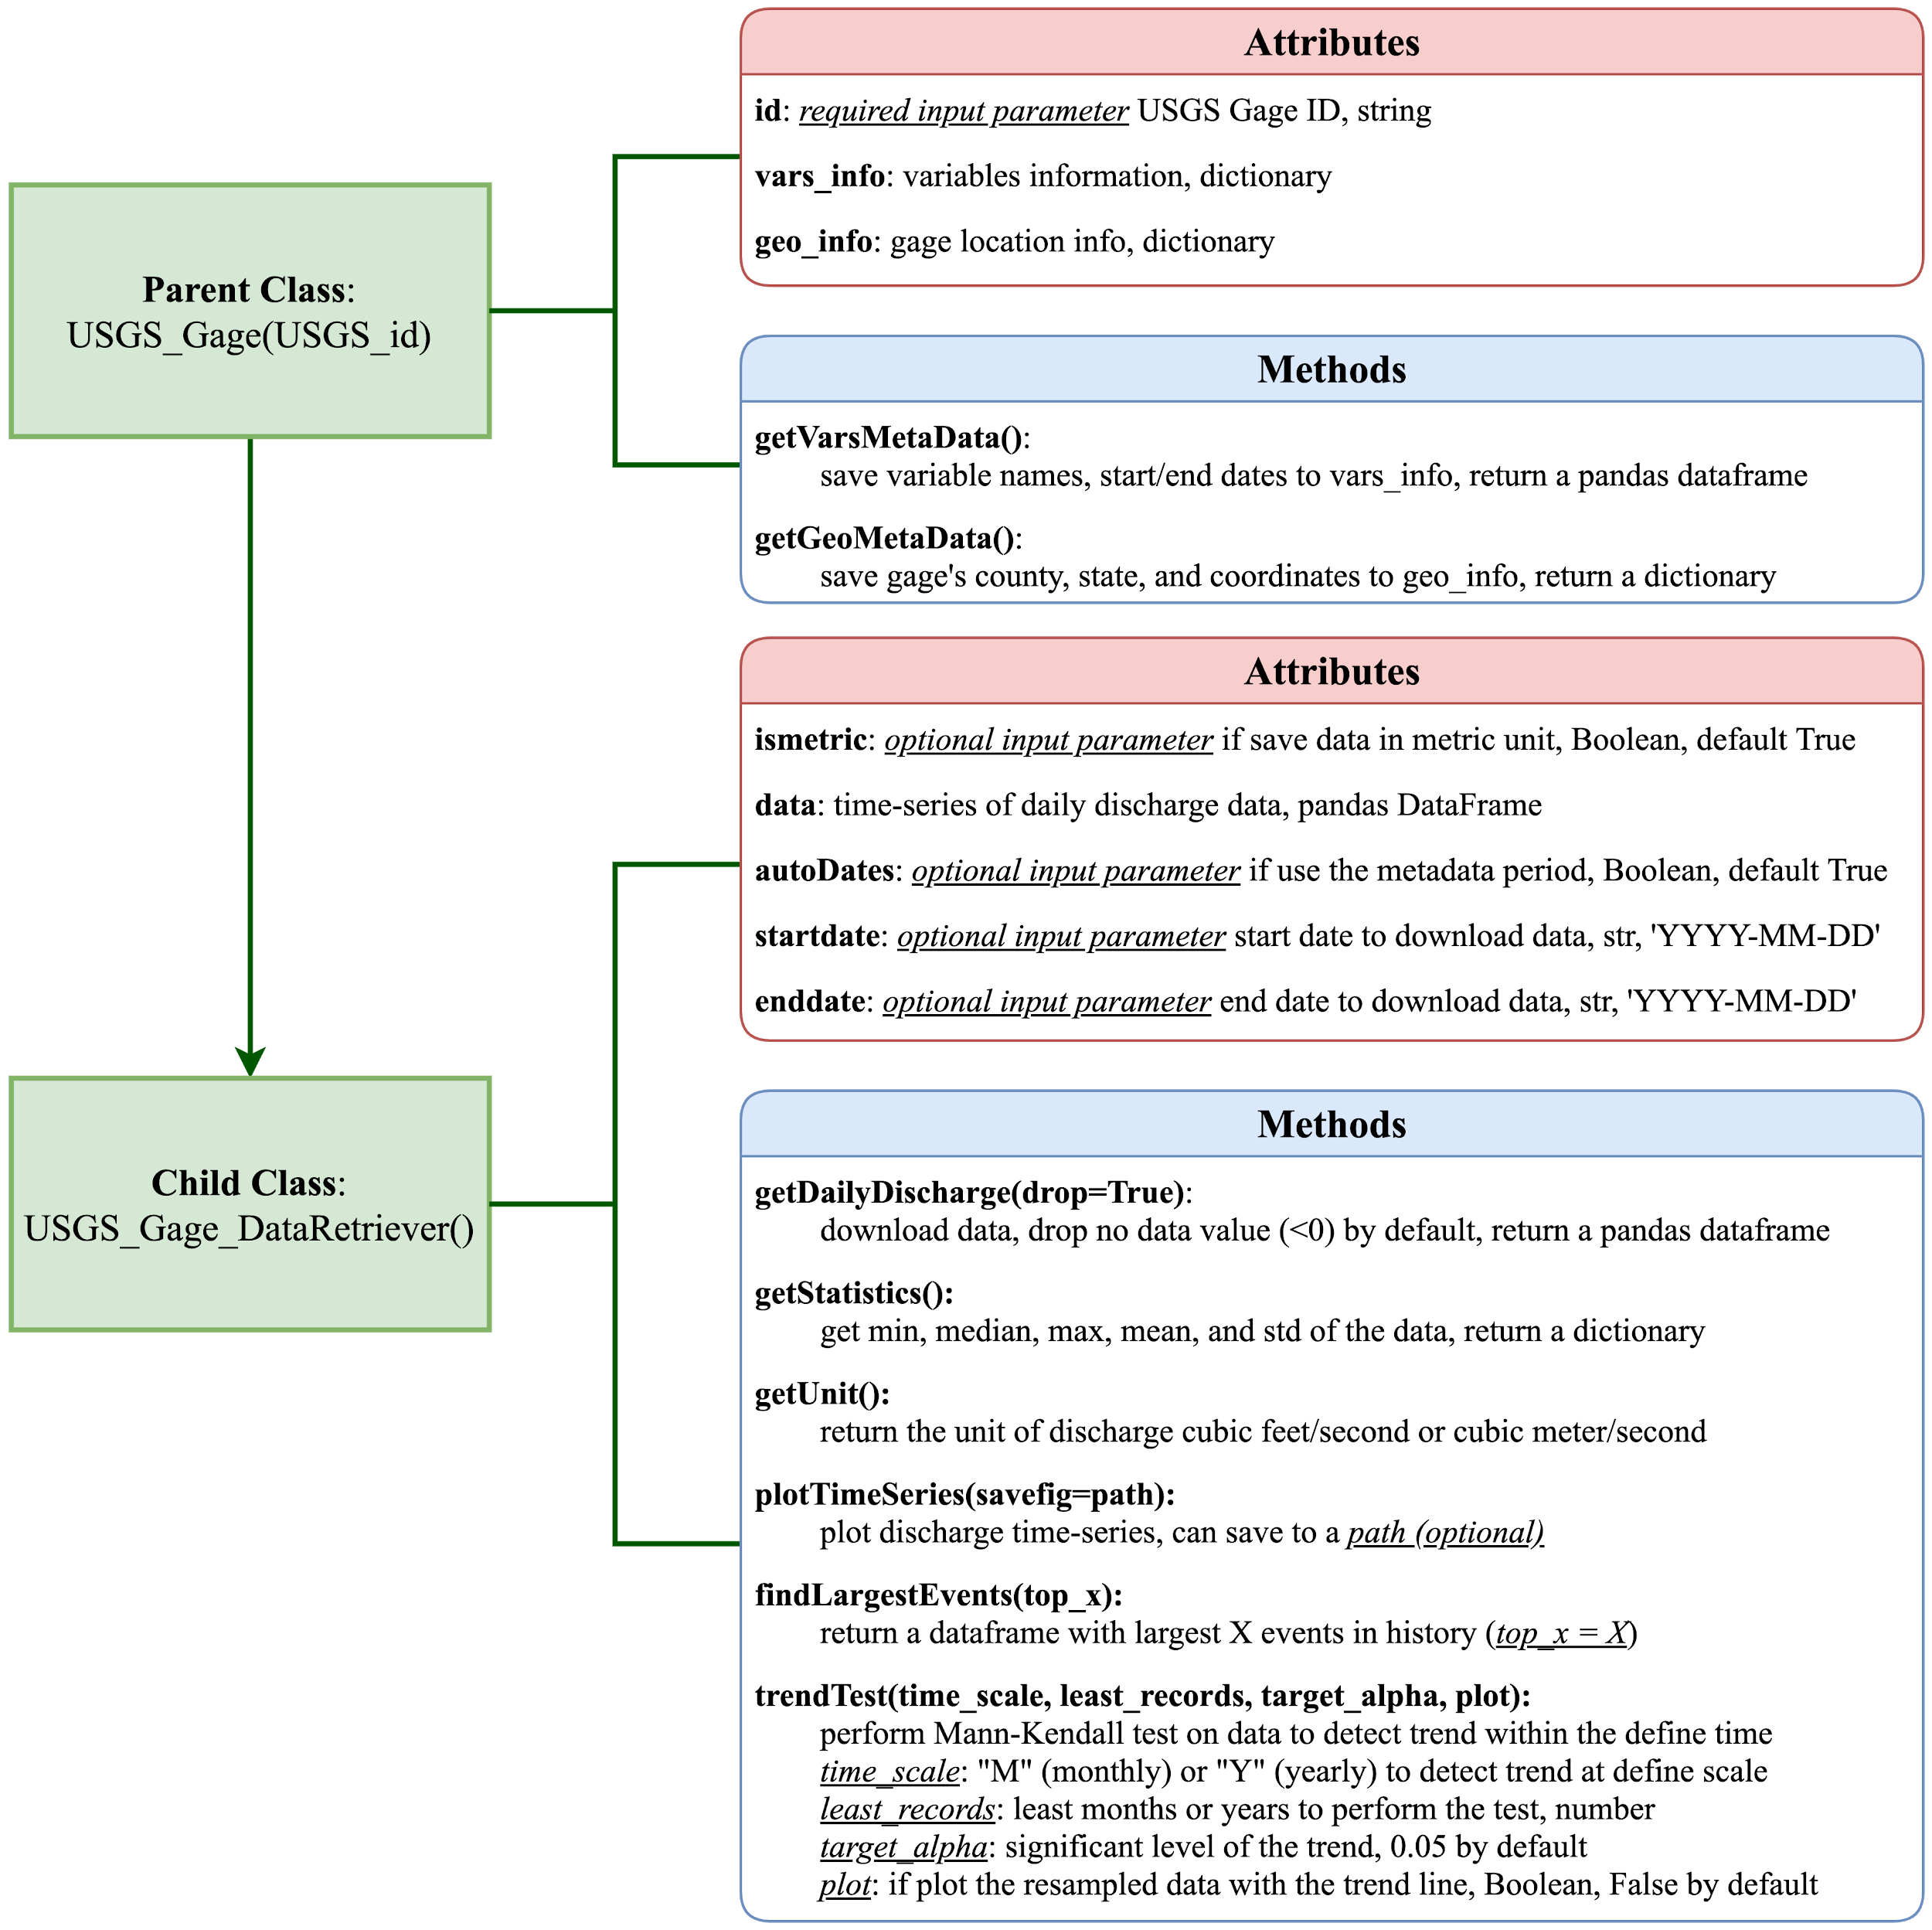
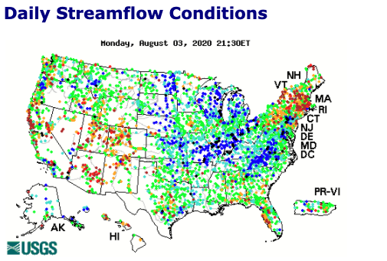

Program Design

Slide 6
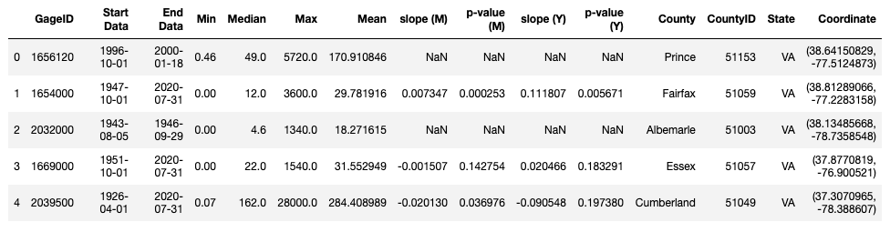
Obtain Data
We looped through all USGS gages within the Chesapeake Bay watershed
Obtain metadata
start/end date of discharge observations
County, state, and geospatial coordinates
Historical minimum, maximum, and mean daily discharge
Detect the trend of discharge
For gages with no less than 10-year observations
On resampled monthly and yearly discharge data, with no-value data dropped
Get the slope value of fitted trend line
All data obtained are saved into a Pandas DataFrame

Slide 7
Trend analysis
Methods
Monotonic trends in target USGS discharge data were calculated using the nonparametric Mann-Kendall test (MKT)¹
Monthly and yearly trends and slopes were investigated on 432 gages in the Chesapeake Bay area which have more than 10 years’ worth of records
The median of the slope and confidence interval were estimated by a simple nonparametric procedure proposed by Sen² (1968).
Time-series analysis
Time series and trend lines for each gage were investigated based on a visual plot
[1] Mann, H. B. (1945), Nonparametric tests against trend. Econometrica, J. Econometric Soc., 245–259, doi:10.2307/1907187. [2] Sen, P. K. (1968), Robustness of some nonparametric procedures in linear models, Ann. Math. Stat., 1913–1922

Slide 8
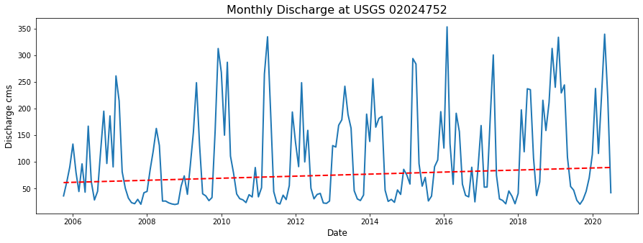
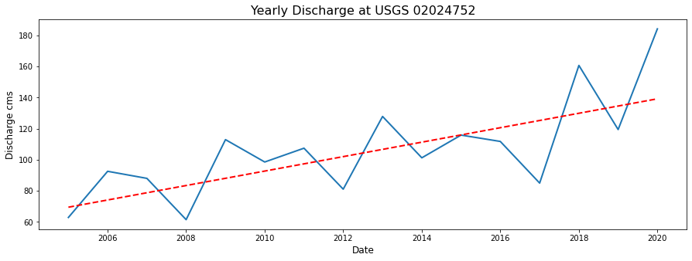
Trend analysis
Figure. Time series of the discharge at 02024752 USGS site with trend line (left: monthly, right: yearly)
If a gage shows significant monthly/yearly trends, the program draws the trend line (red) automatically
Each gage’s statistics can be stored and presented (next slide)

Slide 9
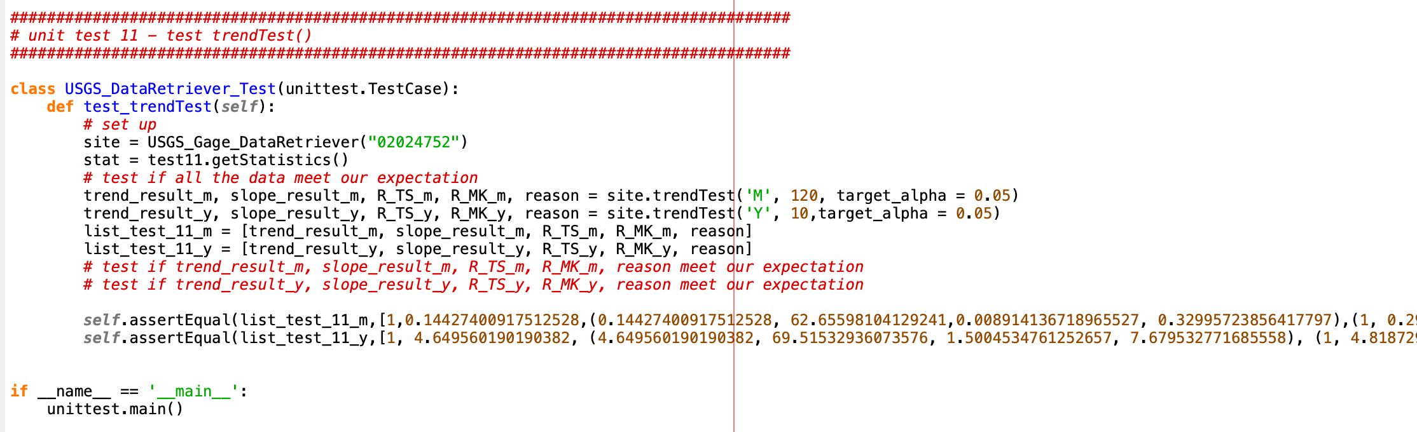
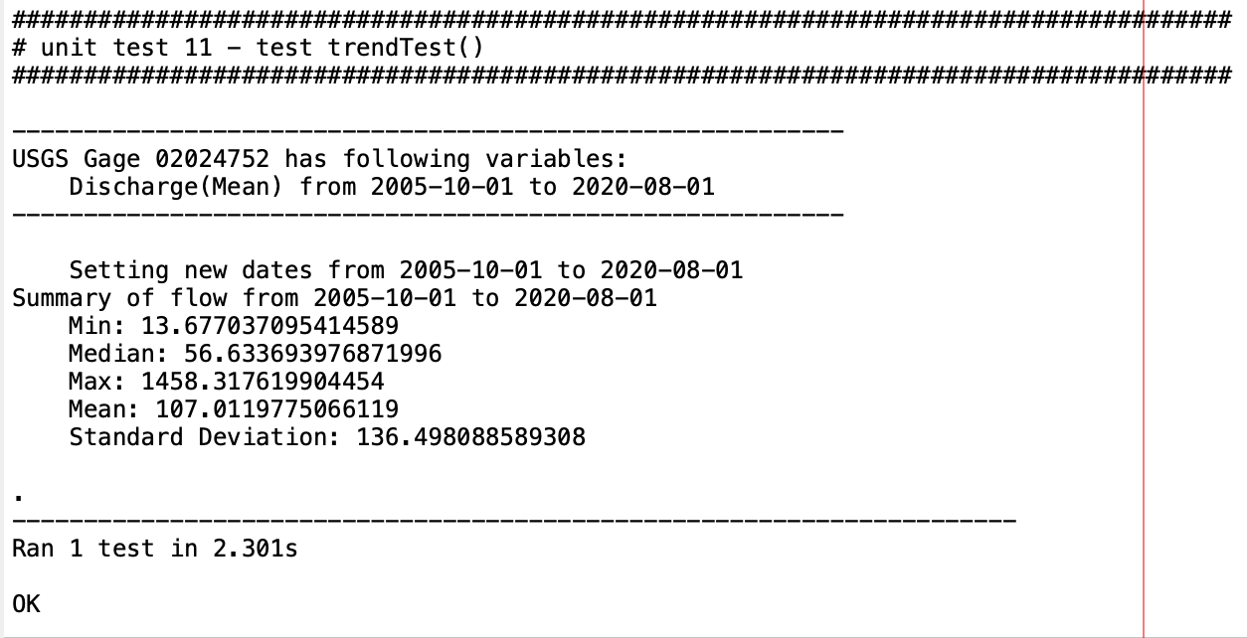
Unit test
Output of test

Slide 10
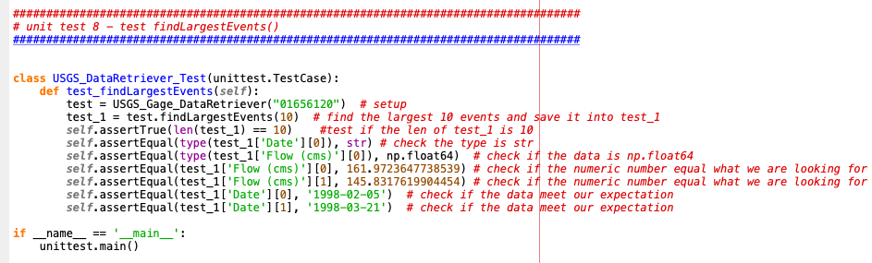
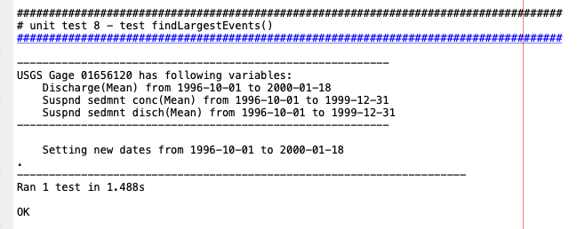
Unit test
Output of test

Slide 11
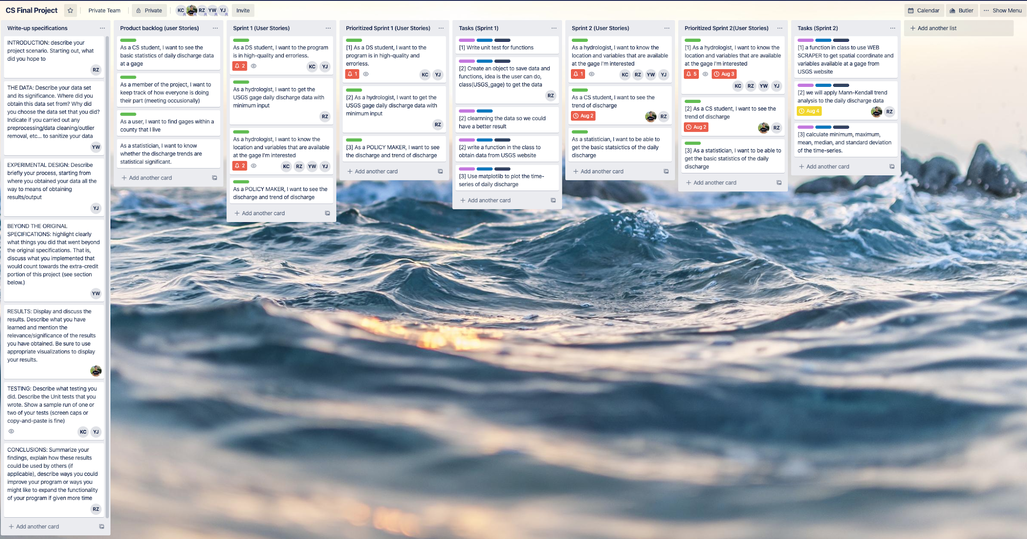
SCRUM
How we accelerate the work process

Slide 12
Results
Data Cleaning
Drop the gages with
Less than 10-year records of discharge
No discharge observations
Query: df [ ~ df [‘slope’].isnull() ]
We fit trend line only if the gage has more than 10-year records, otherwise, null is returned

Slide 13
Results
2. Number of Qualified Gages in Each State
423 gages, with Virginia and Pennsylvania having most gages in Chesapeake Bay Watershed
 | DE | WV | MD | NY | PA | VA | Total
Gages | 2 | 22 | 73 | 45 | 126 | 164 | 423
% | 5% | 5.2% | 17.3% | 10.6% | 29.8% | 38.8% | 100%

Slide 14
Results
3. Trend analysis(Gages with Different Trends on Discharge)
Decreasing trend in Monthly scale is hard to detect
Streamflow has strong seasonality pattern and spikes due to extreme events (e.g., hurricanes)
~60% of gages show no trend of streamflow over 10-years
 | Increasing | Decreasing | No Trend
Yearly | 70 (16%) | 108 (25%) | 254 (59%)
Monthly | 114 (26%) | 32 (8%) | 286 (66%)

Slide 15
Results
4. Trend analysis( Gages with Same Trend on Monthly and Yearly Discharge)
Both increasing accounts for 25% percent, and both decreasing accounts for 6% percent
~70% of gages show inconsistent trend
 | Both Increasing | Both Decreasing | Inconsistent
Monthly & Yearly | 110 (25.5%) | 29 (6.7%) | 293 (67.8%)

Slide 16
Jupyter notebook
1) Interactive Map
We have developed the interactive map to analyse spatial patterns of the trend over the Chesapeake Bay area.
2) Demonstration
The Jupyter notebook link is:
https://nbviewer.jupyter.org/github/ruoyu93/USGS_DataRetriever/blob/ruoyu93-patch-1/test.ipynb

Slide 17
Conclusion
1) We developed a Python program to download the USGS daily data automatically
2) Overall, 67.8% of stations do not show significant trend, while 25.5 % and 6.7 % of stations show a significant increasing and decreasing trend, respectively.
3) The map shows that Northern Virginia and Richmond showed significant decreasing trend
4) Future applications
Downloading 15-min discharge data
Extending our analysis to the entire United States
Developing a flash flood forecasting system

